Slide 1
Developing PCS database for comfort simulation
Background
Some papers show the impact of PCS on thermal comfort, but the methodology is random
e.g. Cooling effects by fans depend on the ambient air temperature
Aaaaa
Aaa
Aaa

Slide 2
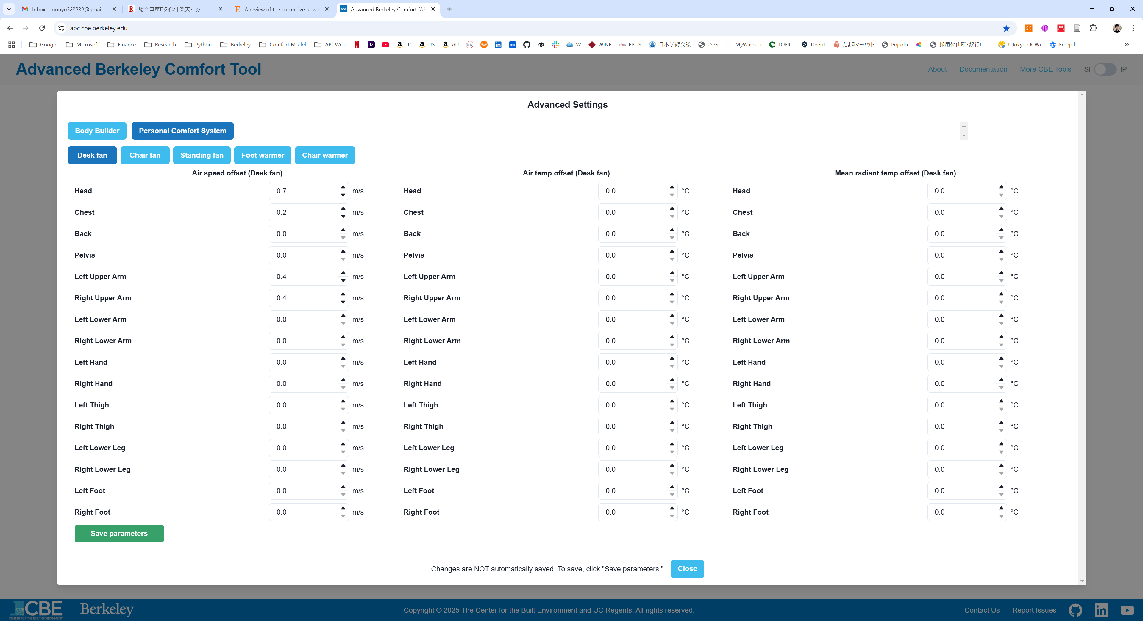
Background: I would like to have typical data for PCS to simulate the impact on human thermal comfort

Slide 3
aaaaa

